Slide 1
System Programming MP0
github register

Slide 2
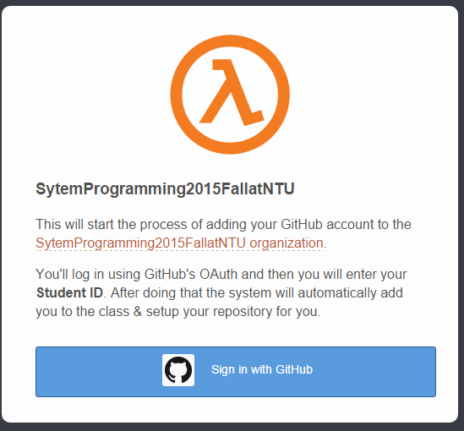
Step 1: Enroll to class repository
http://140.112.28.114:4000/
click it

Slide 3
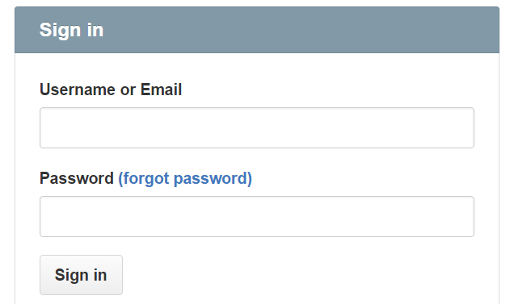
Step 2: log in with your github account
sign in your github account

Slide 4
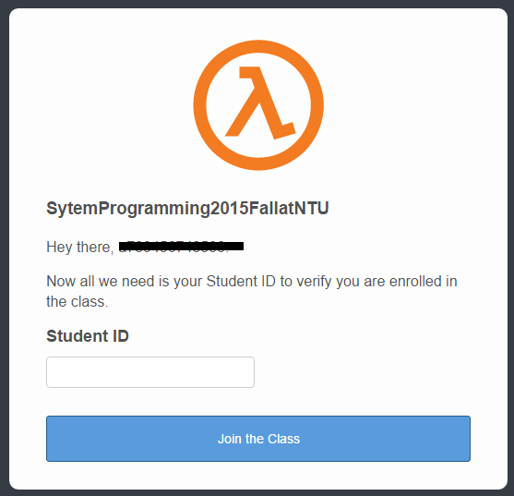
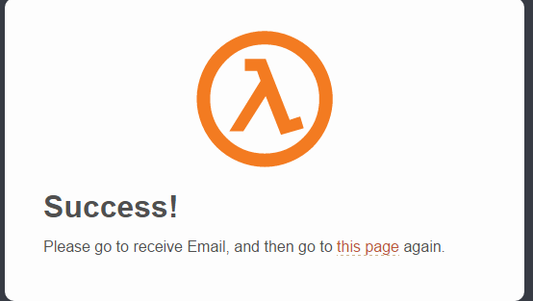
Step 3: provide your NTU student to confirm your enrollment
Provide your NTU Student ID

Slide 5
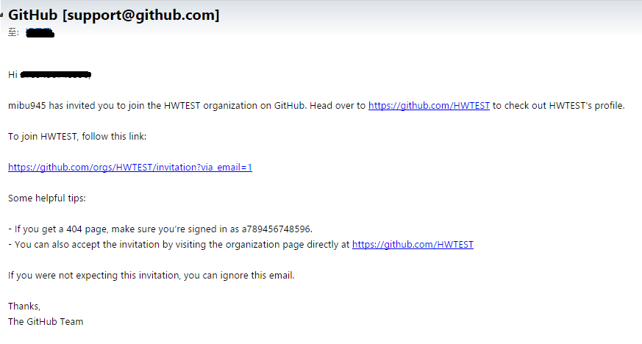
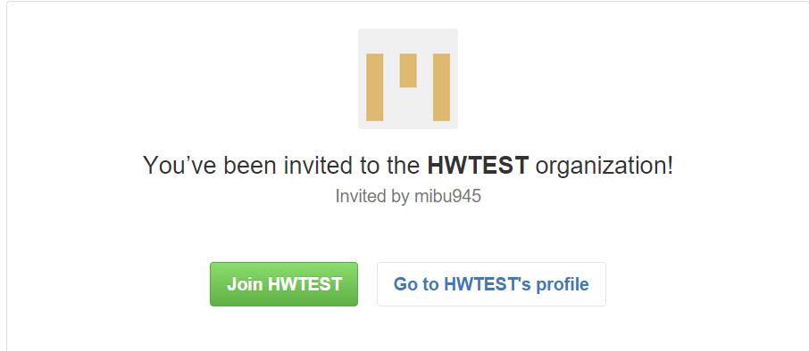
Step 4: Confirm the request
Open your email reader and check email from the github.
Confirm the request.
click it

Slide 6
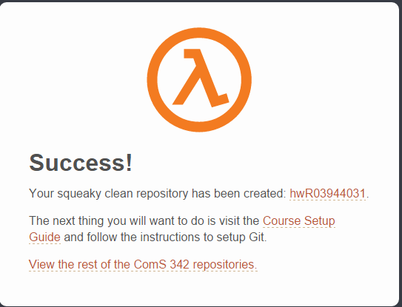
Step 5: Create private repository for your assignments
Visit http://140.112.28.114:4000/ again.
Repeat step.1~ step.3

Slide 7
finish
your repository

Slide 8
Acknowledgement
楊昌民 to prepare the slide deck.
The scripts to add enrolled students and create private repository were revised from the code developed by .
Original source: http://joshldavis.com/2014/06/30/github-university-follow-up/
Revised scripts:

